Slide 1
Time Series Analysis
Yingjie Li

Slide 2
Two Main Goals
(a) Identifying the nature of the phenomenon represented by the sequence of observations
(b) Forecasting (predicting future values of the time series variable)
Both of these goals require that the pattern of observed time series data is identified and more or less formally described

Slide 3
Four Time Series Patterns
Trend(T): A trend exists when there is a long-term increase or decrease in the data. It does not have to be linear. Sometimes we will refer to a trend “changing direction” when it might go from an increasing trend to a decreasing trend.
Seasonal(S): A seasonal pattern exists when a series is influenced by seasonal factors (e.g., the quarter of the year, the month, or day of the week). Seasonality is always of a fixed and known period.
Cyclic(C): A cyclic pattern exists when data exhibits rises and falls that are not of fixed period. The duration of these fluctuations is usually of at least 2 years.
Random(I): The “Random” term is often called “Irregular” in software for decompositions.

Slide 4
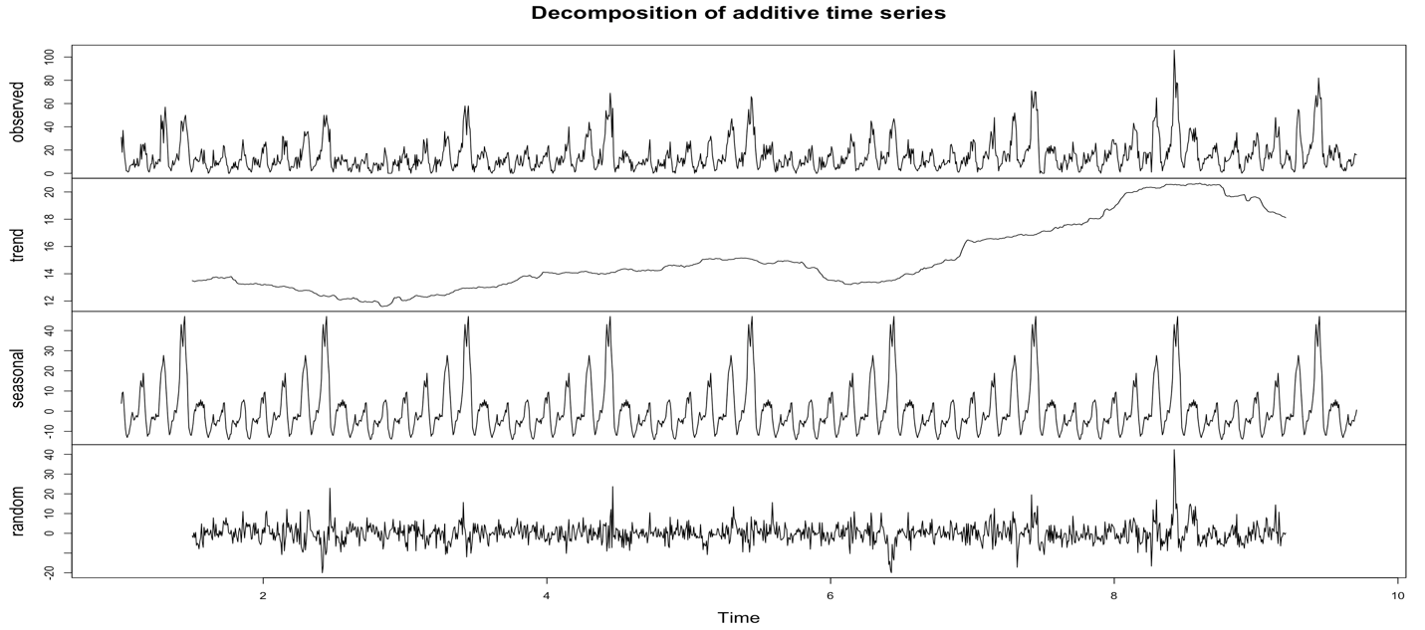

Slide 5
Types of Models
AR(p); MA(q); ARIMA(p, d, q); ARIMA(p, d, q) × (P, D, Q)S.
Decomposition Models.
Single Exponential Smoothing; Double Exponential Smoothing; Holt-Winters Exponential Smoothing.

Slide 6
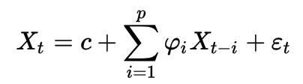

Autoregressive Models (AR(p)) --stationary series
The AR(p) model is defined as:
Where $φ_{1}, …, φ_{p}$ are the parameters of the model, $𝒸$ is a constant, and $ε_{t}$ is white noise.
Each observation is made up of a random error component and a linear combination of prior observations.

Slide 7

Moving Average Models (MA(q)) --stationary series
Let $ε_{t}\sim N(0,σ_{ε}^{2})$, meaning that the $ε_{t}$ are identically, independently distributed, each with a normal distribution having mean 0 and the same variance.
The q^{th} order moving average model, denoted by MA(q) is:
$X_{t}=μ+ε_{t}+θ_{1}ε_{t−1}+θ_{2}ε_{t−2}+…+θ_{q}ε_{t−q}$
Where $θ_{1}, …, θ_{q}$ are the moving average parameters of the model, $μ$ is a constant.
Each observation is made up of a random error component (random shock, ) and a linear combination of prior random shocks.

Slide 8



Differencing (d)
The difference x_{t} - x_{t-1} can be expressed as (1-B)x_{t}.
An alternative notation for a difference is:
$∇=1−B$
Thus:
A subscript defines a difference of a lag equal to the subscript. For instance,
A superscript says to repeat the differencing the specified number of times. As an example,
If there’s an obvious upward or downward linear trend, a first difference may be needed. A quadratic trend might need a 2nd order difference:
Z_{t} = (x_{t}-x_{t-1}) - (x_{t-1}-x_{t-2}). We rarely want to go much beyond two.
For data with a curved upward trend accompanied by increasing variance, you should consider transforming the series with either a logarithm or a square root.

Slide 9
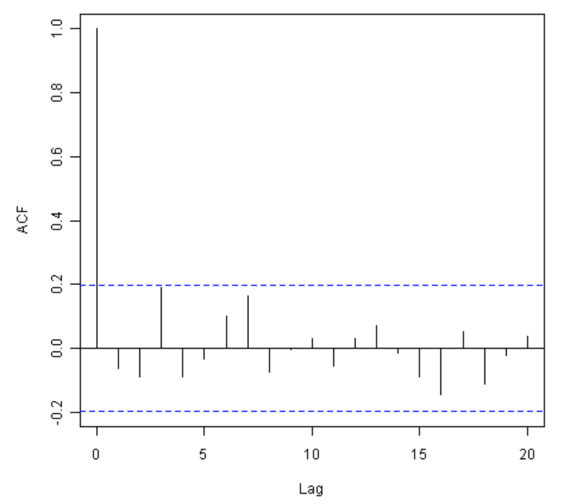
Sample Autocorrelation Function (ACF)—Choose q
The sample autocorrelation function (ACF) for a series gives correlations between the series x_{t} and lagged values of the series for lags of 1, 2, 3, and so on.
ACF for General MA(q) Models:
A property of MA(q) models in general is that there are nonzero autocorrelations for the first q lags and autocorrelations = 0 for all lags > q.
Invertibility of MA models:
An MA model is said to be invertible if it is algebraically equivalent to a converging infinite order AR model. By converging, we mean that the AR coefficients decrease to 0 as we move back in time.

Slide 10
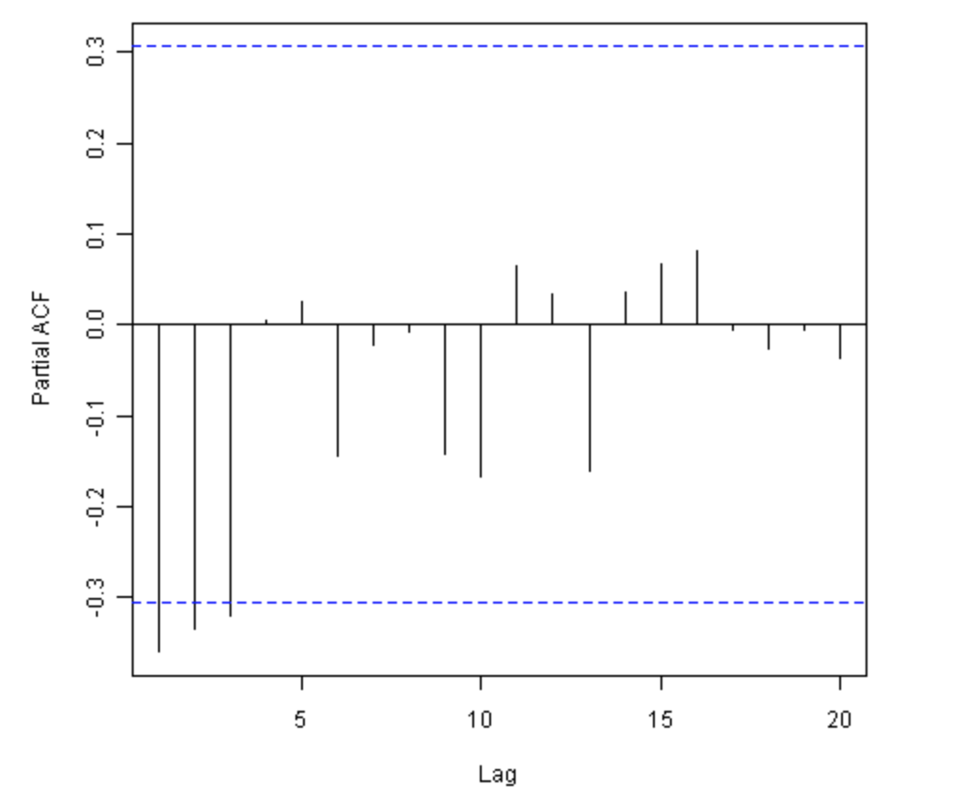
Partial Autocorrelation Function (PACF)—Choose p
For a time series, the partial autocorrelation between x_{t} and x_{t-h} is defined as the conditional correlation between x_{t} and x_{t-h}, conditional on x_{t-h+1}, ... , x_{t-1}, the set of observations that come between the time points t and t−h.
PACF for General AR(p) Models:
For an AR model, the theoretical PACF “shuts off” past the order of the model. The phrase “shuts off” means that in theory the partial autocorrelations are equal to 0 beyond that point. Put another way, the number of non-zero partial autocorrelations gives the order of the AR model. By the “order of the model” we mean the most extreme lag of x that is used as a predictor.

Slide 11
Non-seasonal ARIMA Models (ARIMA(p, d, q))
ARIMA models, also called Box-Jenkins models, are models that may possibly include autoregressive terms, moving average terms, and differencing operations.
1. Specifying the Elements of the Model
2. Identifying a Possible Model
3. Estimating and Diagnosing a Possible Model:
Look at the significance of the coefficients. In R, p-values aren’t given. For each coefficient, calculate z = estimated coeff. / std. error of coeff. If |z| > 1.96, the estimated coefficient is significantly different from 0.
Look at the ACF of the residuals. For a good model, all autocorrelations for the residual series should be non-significant. If this isn’t the case, you need to try a different model.
Look at Box-Pierce (Ljung) tests for possible residual autocorrelation at various lags (see Lesson 3.2 for a description of this test).(Example)
If non-constant variance is a concern, look at a plot of residuals versus fits and/or a time series plot of the residuals.
4. Forecasting with ARIMA Models
Seasonal

Slide 12
ACF and PACF
AR models have theoretical PACFs with non-zero values at the AR terms in the model and zero values elsewhere. The ACF will taper to zero in some fashion.
An AR(2) has a sinusoidal ACF that converges to 0. (Example)
MA models have theoretical ACFs with non-zero values at the MA terms in the model and zero values elsewhere. (Example)
ARMA models (including both AR and MA terms) have ACFs and PACFs that both tail off to 0. These are the trickiest because the order will not be particularly obvious. Basically you just have to guess that one or two terms of each type may be needed and then see what happens when you estimate the model. (Example)
If the ACF and PACF do not tail off, but instead have values that stay close to 1 over many lags, the series is non-stationary and differencing will be needed. Try a first difference and then look at the ACF and PACF of the differenced data.
If all autocorrelations are non-significant, then the series is random (white noise; the ordering matters, but the data are independent and identically distributed.) You’re done at that point.
If you have taken first differences and all autocorrelations are non-significant, then the series is called a random walk and you are done.

Slide 13
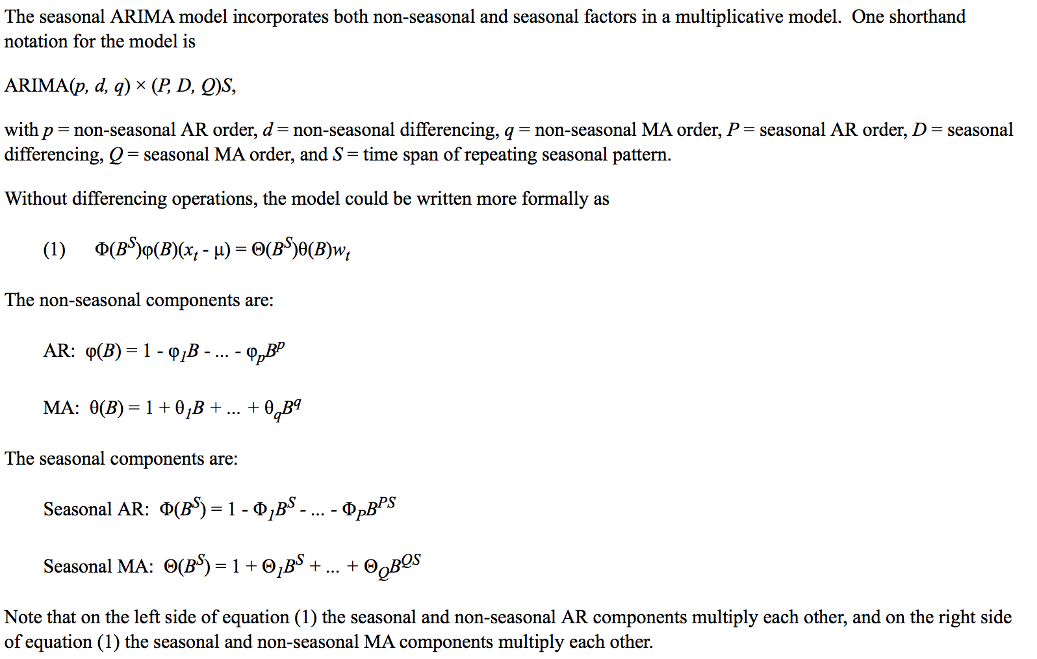
Seasonal ARIMA models (ARIMA(p, d, q) × (P, D, Q)S)
Examples

Slide 14
Decomposition Models --Trend and Seasonal factors
One of the main objectives for a decomposition is to estimate seasonal effects that can be used to create and present seasonally adjusted values. A seasonally adjusted value removes the seasonal effect from a value so that trends can be seen more clearly.
The following two structures are considered for basic decomposition models:
1. Additive: x_{t} = Trend + Seasonal + Random; x_{t} = T_{t} + S_{t} + I_{t}
2. Multiplicative: x_{t} = Trend * Seasonal * Random; x_{t} = T_{t} * S_{t} * I_{t}
How to Choose Between Additive and Multiplicative Decompositions:
1. The additive model is useful when the seasonal variation is relatively constant over time.
2. The multiplicative model is useful when the seasonal variation increases over time.

Slide 15
Basic Steps in Decomposition
1. The first step is to estimate the trend. Two different approaches could be used for this (with many variations of each).
One approach is to estimate the trend with a smoothing procedure such as moving averages. With this approach no equation is used to describe trend.
The second approach is to model the trend with a regression equation.
2. The second step is to “de-trend” the series. For an additive decomposition, this is done by subtracting the trend estimates from the series. For a multiplicative decomposition, this is done by dividing the series by the trend values.
3. Next, seasonal factors are estimated using the de-trended series. For monthly data, this entails estimating an effect for each month of the year. For quarterly data, this entails estimating an effect for each quarter. The simplest method for estimating these effects is to average the de-trended values for a specific season. For instance, to get a seasonal effect for January, we average the de-trended values for all Januarys in the series, and so on. (Minitab uses medians rather than means, by the way.)
The seasonal effects are usually adjusted so that they average to 0 for an additive decomposition or they average to 1 for a multiplicative decomposition.
4. The final step is to determine the random (irregular) component.
For the additive model, random = series – trend – seasonal.
For the multiplicative model, random = series / (trend*seasonal)
Example

Slide 16

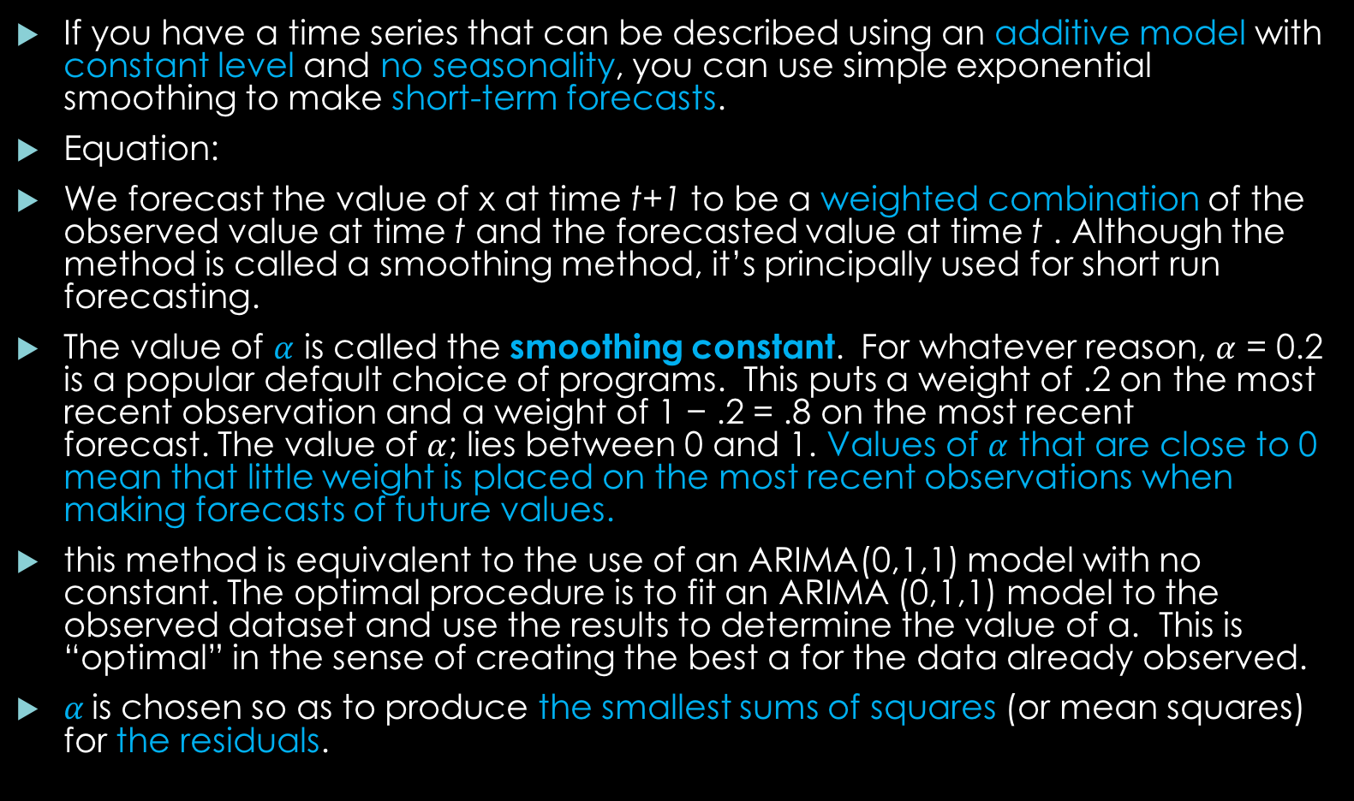
Single Exponential Smoothing
If you have a time series that can be described using an additive model with constant level and no seasonality, you can use simple exponential smoothing to make short-term forecasts.
Equation:
We forecast the value of x at time t+1 to be a weighted combination of the observed value at time t and the forecasted value at time t . Although the method is called a smoothing method, it’s principally used for short run forecasting.
The value of $α$ is called the smoothing constant. For whatever reason, $α$ = 0.2 is a popular default choice of programs. This puts a weight of .2 on the most recent observation and a weight of 1 − .2 = .8 on the most recent forecast. The value of $α$; lies between 0 and 1. Values of $α$ that are close to 0 mean that little weight is placed on the most recent observations when making forecasts of future values.
this method is equivalent to the use of an ARIMA(0,1,1) model with no constant. The optimal procedure is to fit an ARIMA (0,1,1) model to the observed dataset and use the results to determine the value of α. This is “optimal” in the sense of creating the best α for the data already observed.
$α$is chosen so as to produce the smallest sums of squares (or mean squares) for the residuals.

Slide 17
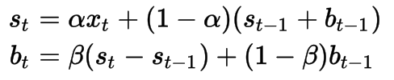

Double Exponential Smoothing(Holt’s)
Double exponential smoothing might be used when there's trend (either long run or short run), but no seasonality.
Equation:
Where α is the data smoothing factor, 0 < $α$ < 1, and β is the trend smoothing factor, 0 < $β$ < 1.
Holt’s exponential smoothing estimates the level and slope at the current time point. Smoothing is controlled by two parameters, $α$, for the estimate of the level at the current time point, and $β$ for the estimate of the slope b of the trend component at the current time point. As with simple exponential smoothing, the parameters $α$ and $β$ have values between 0 and 1, and values that are close to 0 mean that little weight is placed on the most recent observations when making forecasts of future values.
The procedure is equivalent to fitting an ARIMA(0,2,2) model, with no constant; it can be carried out with an ARIMA(0,2,2) fit.

Slide 18
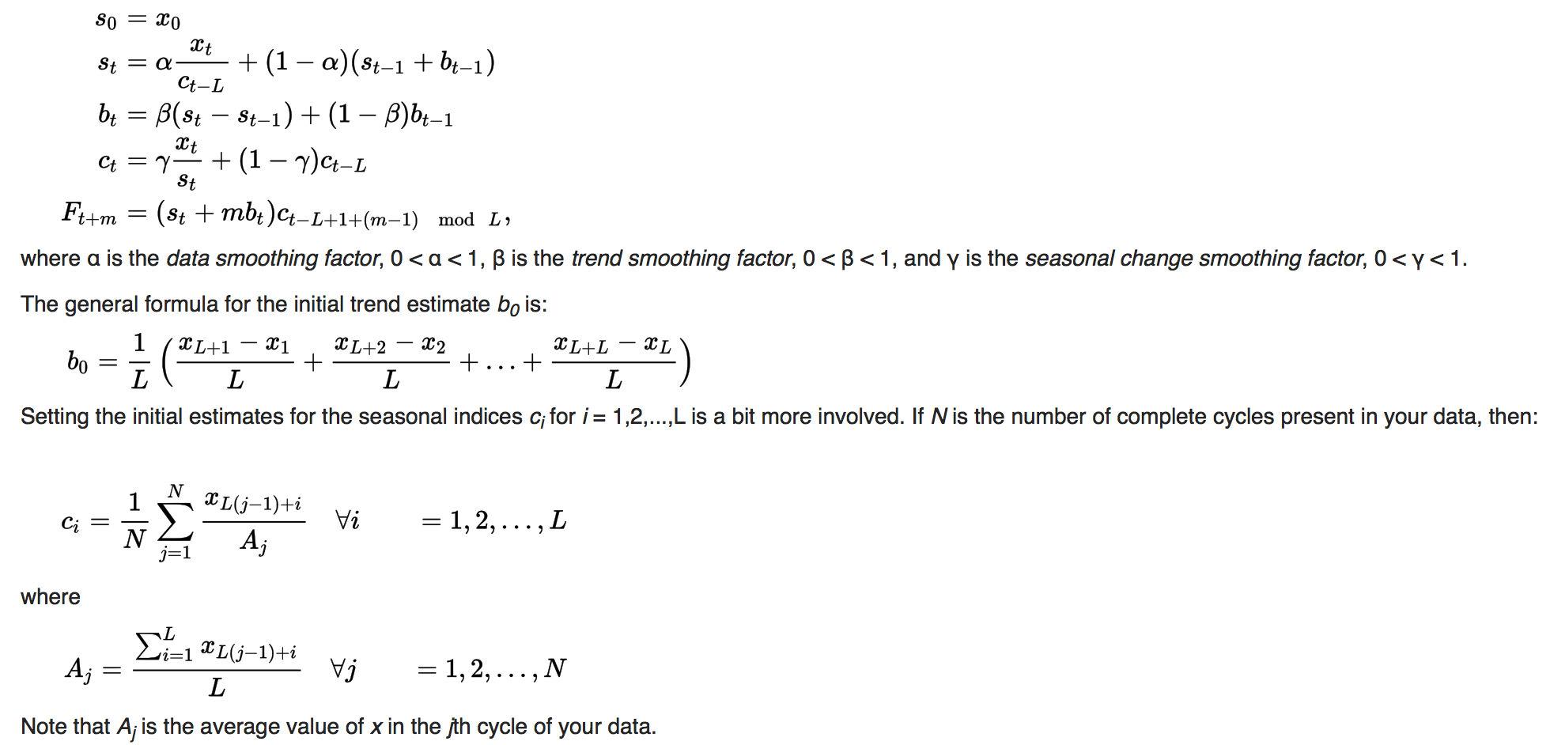
Triple exponential smoothing(Holt-Winters)
If you have a time series that can be described using an additive model with increasing or decreasing trend and seasonality, you can use Holt-Winters exponential smoothing to make short-term forecasts.
Triple exponential smoothing with multiplicative seasonality is:

Slide 19
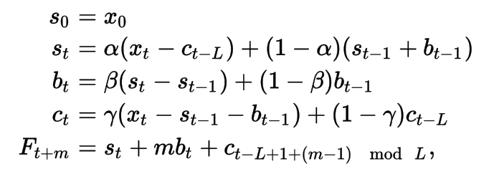

Continues:
Triple exponential smoothing with additive seasonality is given by:
Holt-Winters exponential smoothing estimates the level, slope and seasonal component at the current time point. Smoothing is controlled by three parameters: $α$, $β$, and $γ$, for the estimates of the level, slope b of the trend component, and the seasonal component, respectively, at the current time point. The parameters $α$, $β$ and $γ$ all have values between 0 and 1, and values that are close to 0 mean that relatively little weight is placed on the most recent observations when making forecasts of future values.
Diagnosing

Slide 20
Thanks~~

Slide 21
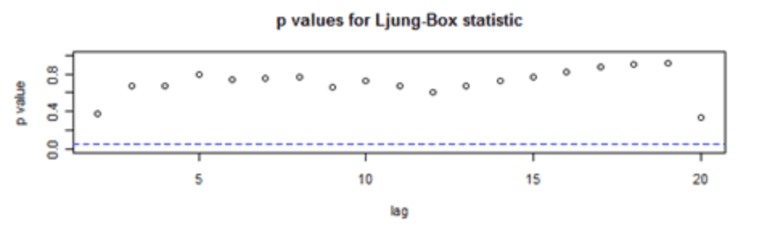
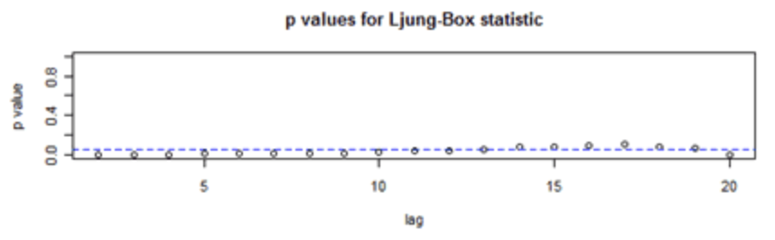
Ljung-Box-Pierce Test

